Slide 1
Strategies to support your child with learning at home
Jill Warburton
Stockport Inclusion Service

Slide 2
Reading

Slide 3
FAMILIAR READING
It will help YOUR CHILD to:
build confidence & self-esteem
revise tricky words or new vocabulary
explore expression and focus on punctuation
develop independence as a reader
And it will give YOU the opportunity to:
PRAISE
ask questions
PROMPT if necessary
let your child be in charge

Slide 4
PRAISE
Praise is very important to maintaining and building self-esteem, motivation and reading confidence. It also encourages children to continue using reading strategies they already do well.
PROMPTS
Appropriate prompts encourage children to use strategies that they are not yet using independently themselves.

Slide 5
READING IS ABOUT UNDERSTANDING
Even if you think your child is reading well, check if they understand what they read.
Before you read………TALK ABOUT THE BOOK.
At the end – ASK ‘WH’ QUESTIONS
WHat is the girl’s name?
WHen are they leaving?
WHere are the lost keys?
WHo knew the magic spell?
WHy are they creeping?
PRAISE them for what they do know!!

Slide 6
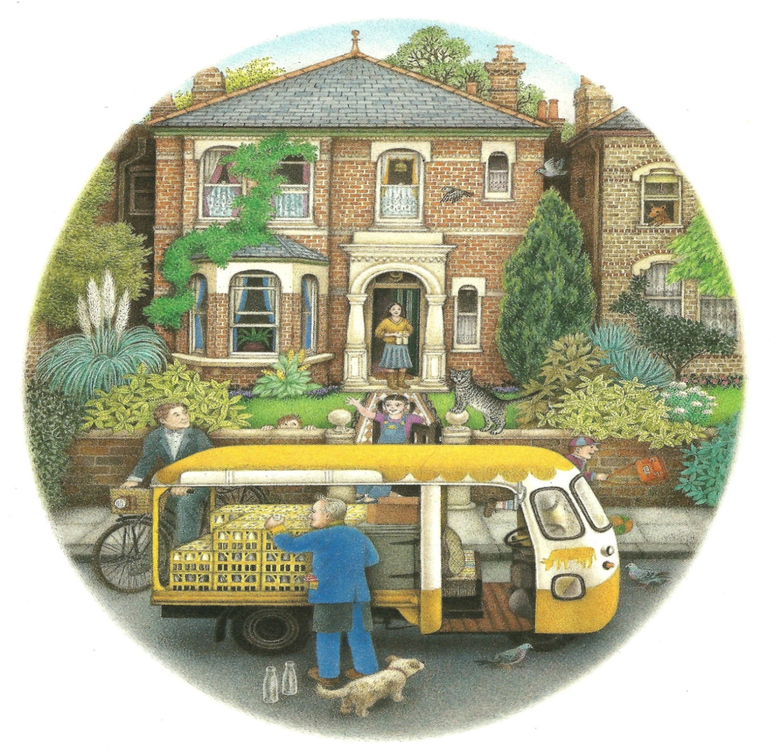
How many children are outside the house?
How does dad travel to work?
How do we know it is not a cold day?
Why is there a cow painted on the van?
What do you think the cat will do now?

Slide 7
The general level of difficulty of question increases… A “What is?” question is normally easier to create and answer than a “How might?” question.

Slide 8
How to help….but not too much!
Try to avoid ‘giving’ your child unknown words but encourage them to use 3 sources of information:

Slide 9
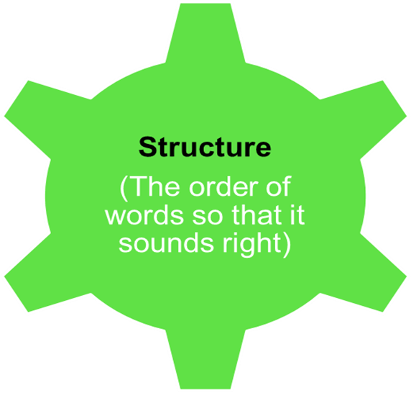
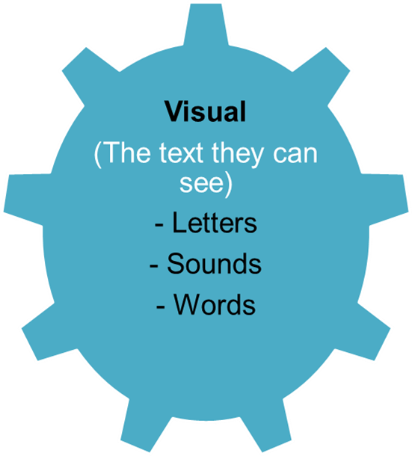

Slide 10
WHAT IF THEY DON’T KNOW A WORD?

Slide 11
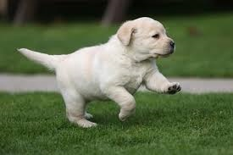
The dog ran up the hill.
Child says:
The puppy ran up the hill.
The duck ran up the hill.
The dog runned up the hill.

Slide 13
Reluctant Readers

Slide 14
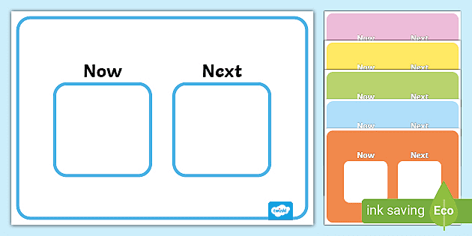
Make reading a habit …same time each night
Sit at a table
Child to hold the book
Use clear instructions linked to ‘reward’ after: First …Then…/ When you have…we will..
Use Games such as reading SNAP or Pairs
Take it in turns to read page/line/word

Slide 15
My reading challenge
I read for 2 minutes | Someone has read to me | I read for 5 minutes
I skipped reading today | I played a word game | I chose a book to read
I read to someone of my choice | I read for 10 minutes | I have read a book in a strange place

Slide 16
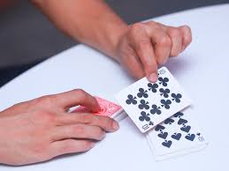
Snap -Play these games with 2 people. -Make cards from cereal packs etc (you needs at least 12 cards) -Write the same word on 2 cards | Pairs Put cards face down on table & turn 2 over. If they match keep them. If not it’s the other player’s turn! This is a fun memory game. | My Pile Your Pile Shuffle all cards and turn over top card. If you can read it you keep it. If not, the person you are playing against gets it!

Slide 17
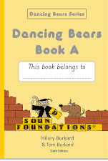
Audio books allow children to access age appropriate texts (child to follow paper copy of book to read whilst they listen)
Online books such as Oxford Owls
Toe by Toe/Dancing Bears are easy to follow programmes for children who find reading difficult

Slide 18
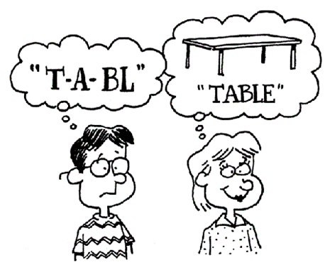
Spelling

Slide 19
Multi-sensory activities will help your child remember spellings better.
Visual
Auditory
Kinaesthetic (movement)

Slide 20
Colours for word families/rhymes as visual prompt: rain train main plain Spain
Use boxes as visual prompt for ‘tricky’ words, to show word shapes
said what they
Teach how to split words into syllables. Different colours for each syllable
Highlighter pens to show syllables/ spelling patterns/rhymes

Slide 21
Write your spellings in Bubble Writing | Write your words using Wiggly letters
Write your words using different colours Rainbow spelling | Write your words in the air & then on paper Air writing
Copy spellings with the hand you DON’T normally use! Wrong Hand | Newspapers Cut out letters from newspapers to make your words
Spell your word out loud, letter by letter, popping a bubble each time or write on sandpaper Bubble wrap | Write your words using 1 colour for vowels & 1 for consonants Vowels & Consonants

Slide 22
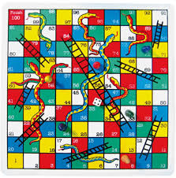
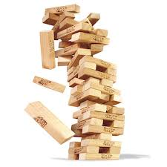
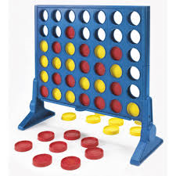
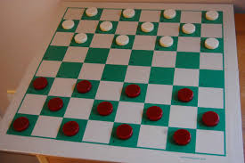
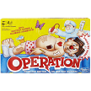
Snakes & Ladders Read or spell a word every time you roll the dice
Jenga Read/spell word every time you take a block out
Connect 4 Read/spell word every time you put a piece in
Draughts Read/spell word when you put draught down
Operation Read/spell word every time buzzer goes off!

Slide 23
Writing
Parents often report that their child is reluctant to do writing at home.
Make it fun by having coloured pens & coloured paper.
Get your child to say what they want to write BEFORE they write it.
If they can’t say it they can’t write it!
Have a practice page & a perfect page
Quality rather than quantity
Some children prefer to write on a laptop

Slide 25
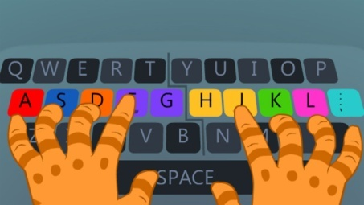
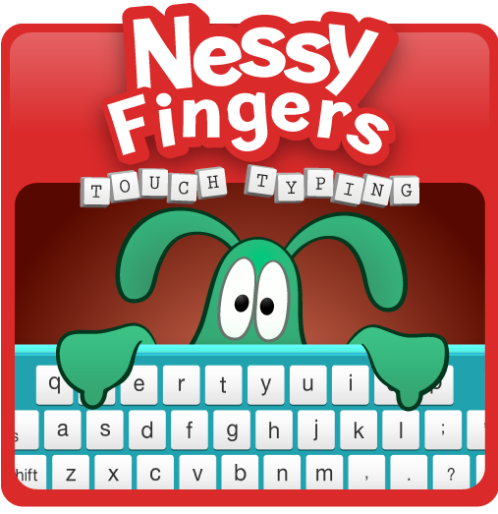
Touch Typing
This is very useful skill to practise at home.
BBC Dance Mat Typing (free)
Doorway Online (free)
Touch-type Read & Spell
Nessy Fingers (£30 year)

Slide 26
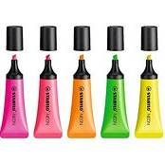
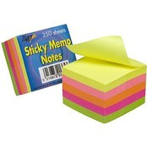
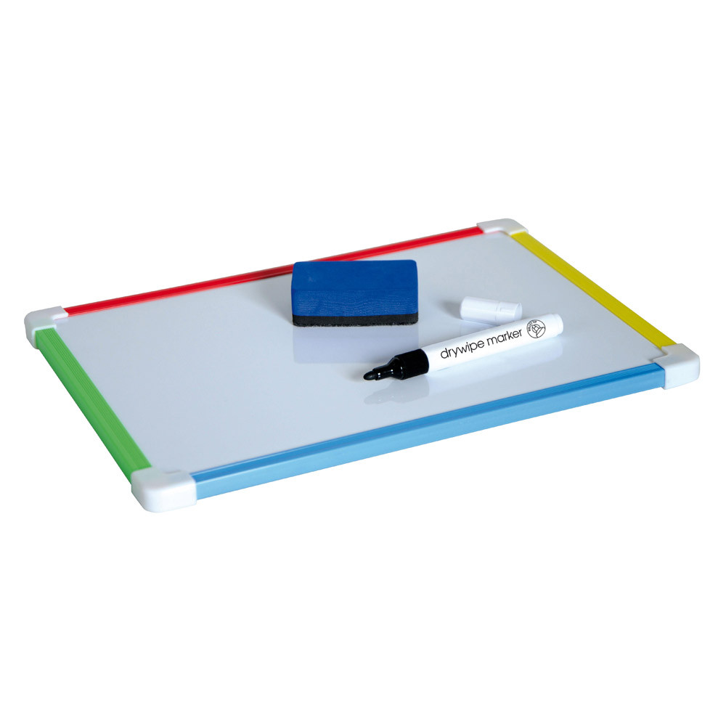
Useful resources

Slide 27
What works best for learners with
dyslexia?
• Multi-sensory (hearing/seeing/moving, touching, feeling)
• Bite-size chunks (little & often)
• Over-learning (keep practising & revising)

Slide 28
Maths

Slide 29
Point out maths in everyday life (e.g. looking at prices in a shop, working out change)
Talk positively about maths (try not to mention negative experiences you may have had)
Short bursts are best
Point out how ‘wrong’ answers are useful and help us learn
Start at a level your child is confident with
Praise lots and keep it fun!!

Slide 30
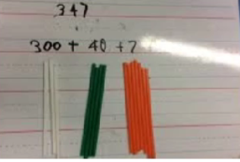
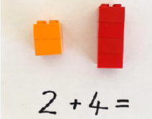
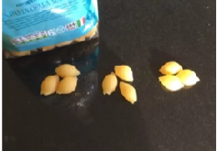
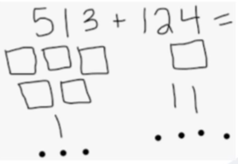
What can you do to help?
Use real life objects (straws, Lego bricks or pasta shapes) to show numbers
Use drawings to help
Allow them to use their fingers

Slide 31
Finally…
Be positive, praise and prompt
Use real life objects, drawing and scenarios where possible
Talk about maths and letters whilst you are ‘out and about’ incidentally
Short bursts are best
Recover and over learn to ensure they are transferred to their long term memory
Play games and make it fun to reduce anxiety
Have FUN!

Slide 32
Thank you for listening. Any questions?

